Slide 1
Processing Tabular Models & Power BI Datasets
Bill Anton

Slide 2








Bill Anton
anton@opifexsolutions.com
Downloads and additional references:
https://github.com/byobi/PBI-Refresh

Slide 3
Agenda
Housekeeping
Architecture
Data Structures
Processing Options
Common Strategies

Slide 4

Housekeeping #1
as of June 27, 2020
Analysis Services
Object-Level Security
Dynamic Scale-Up/Out
Perspectives
Cost*
Power BI
All other scenarios
https://powerbi.microsoft.com/en-us/blog/power-bi-premium-and-azure-analysis-services/
Notes:
No one really uses perspectives.

Slide 5
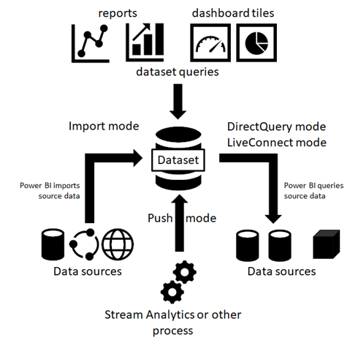
Housekeeping #2

Slide 6
Architectures

Slide 7
Architecture

Slide 8
Architecture

Slide 9
Architectures
Notes:
Finance, Healthcare

Slide 10
Architectures
Key Points
Many different architectures
(higher) Security comes at a cost (money and performance)
The mechanics of processing does not change…

Slide 11
Data Structures 101
Database
Model
Table A
Table B
Column A
Column B
Column A
Column B

Slide 12
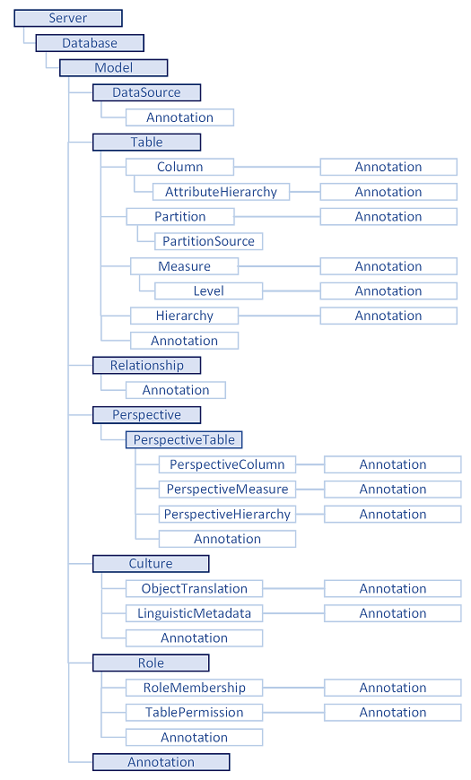
Data Structures 101 201

Slide 13
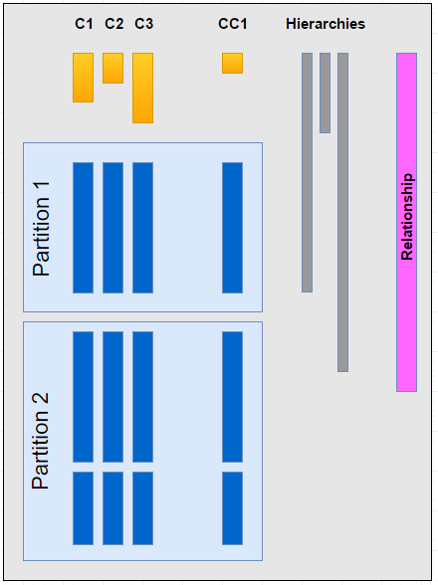
Data Structures 101 201 301
Dictionaries
1 per column
Value vs Hash
Partitions
At least 1 per table (standard vs enterprise)
made up of 1 or more segments
Segments
a “chunk” of rows (default: 8mm**)
Configurable at the instance-level
Calculated Columns
Stored like regular columns
Good or bad?
Hierarchies
e.g. Calendar Year -> Month -> Date
Can improve query performance
Relationships
Optimizes lookups & filtering across tables
Notes:
Value vs Hash
Value > Hash (query performance)
Hash is always used for strings
Not always possible for numeric columns
Dates are numeric columns (under the covers)
See https://channel9.msdn.com/Events/TechEd/Australia/2012/DBI315
Hints available with 2017 (e.g. processing large table with lots of segments… last segment realize you can no longer use value encoding…
** For tables w/ < 16mm rows, only 1 segment is created.
Segments cannot cross partitions
Small tables (< 16mm rows), only 1 segment
DefaultSegmentRowCount to increase # of rows / segment
Advanced
Segment is the basis for parallelism in queries (1 core/segment)

Slide 14

Every time you create a calculated column…
…a kitten DIES!!!
Notes:
At best they’re a shortcut to save time.
At worst they cause serious performance and scalability problems.
Most of they time they just add to technical debt by spreading out the business logic making the solution more difficult to maintain over time.

Slide 15

Processing Options
Power BI Pro
8x / day
entire dataset or “easy-mode” incremental
Power BI Premium
48x / day (unlimited via Rest API)
fine-grained control (aka “hard-mode”)
Analysis Services
unlimited / day
fine-grained control (aka “hard-mode”)
Notes:
From processing perspective, Analysis Services is a subset of Premium

Slide 16
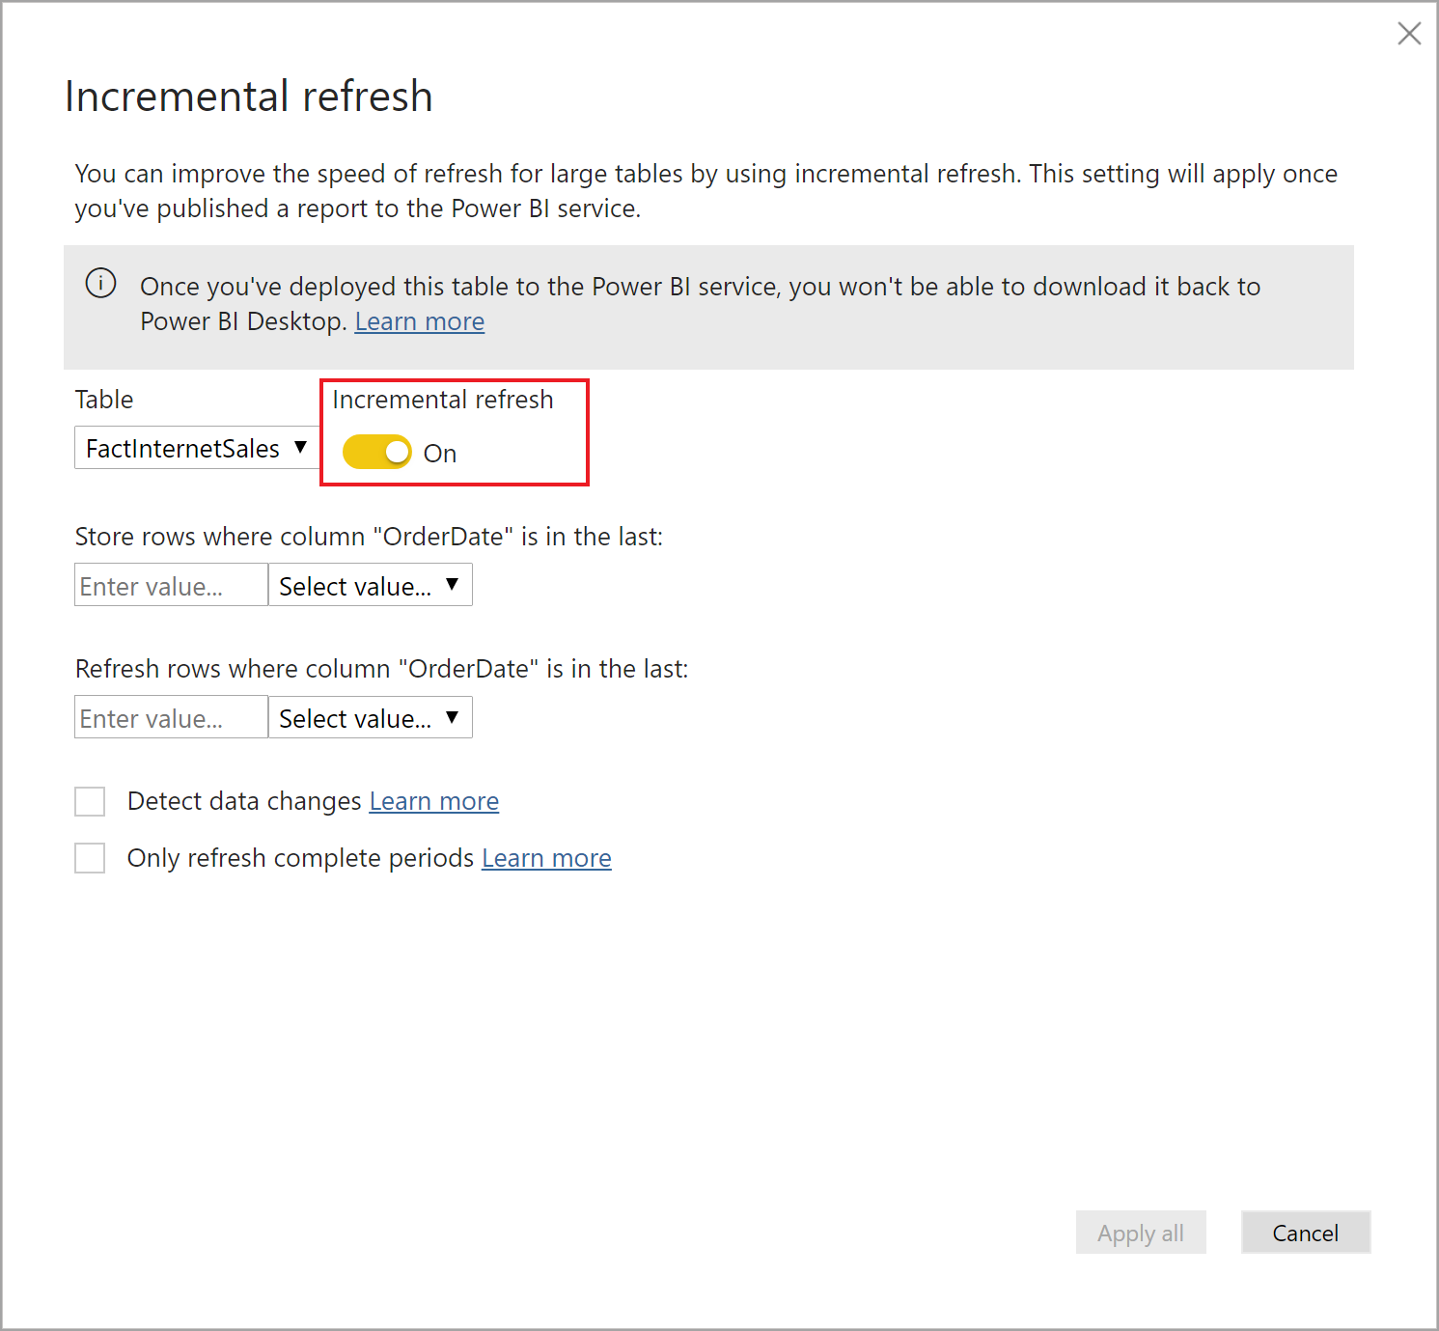
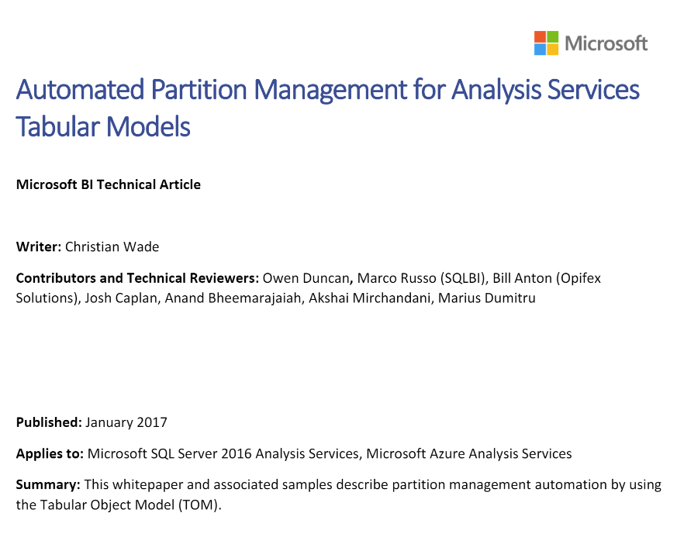
Processing Options
Easy Mode
Hard Mode
Notes:
Power BI Incremental Refresh: https://docs.microsoft.com/en-us/power-bi/admin/service-premium-incremental-refresh
AS Partition Manager: https://github.com/microsoft/Analysis-Services/blob/master/AsPartitionProcessing/Automated%20Partition%20Management%20for%20Analysis%20Services%20Tabular%20Models.pdf

Slide 17
Demo 01: The Basics
Notes:
Manual Refresh
Scheduled Refresh
Incremental “Easy-Mode”
Power BI Rest API

Slide 18
Processing Commands (AS & PBI Premium)
Command | Description
ProcessDefault | processes any objects (tables, partitions, etc) that are currently in an unprocessed
ProcessData | reads data from source and builds compressed dictionaries and partition segments
ProcessRecalc | builds any calculated columns, calculated tables, hierarchies, and/or relationships that need to be rebuilt.
ProcessFull | ProcessData + ProcessRecalc
ProcessAdd | appends new data to existing data + ProcessRecalc
ProcessClear | empties all data from the model
ProcessDefrag | Rebuilds dictionaries to clear out values that no longer exist
Notes:
Comments:
ProcessData doesn’t rebuild dictionaries when run on a partition (so Defrag)
ProcessAdd is much more complicated than it seems
Questions:
Why would a dictionary need to be rebuilt?
Defrag…
- needed only when processing at partition level (because dictionary bloat)

Slide 19
Phases of Processing
Open connection
Execute SQL (or M-code)
Encoding
Compression
Build Hierarchies, Relationships, Calculated Columns & Tables
Notes:
Encoding
Values are stored as integers
VALUE > HASH
Avoid Re-Encoding if possible
Compression
“Proprietary”
Timeboxing

Slide 20
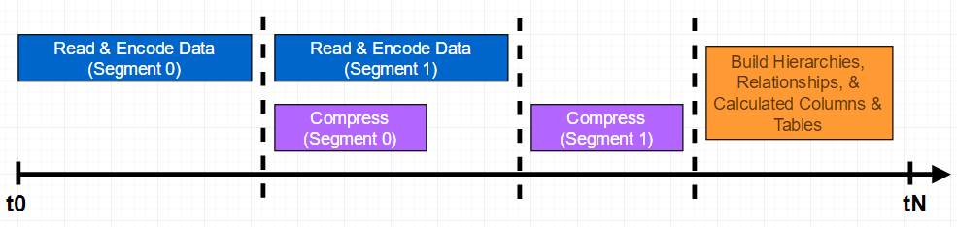
Processing Phases
Segment = 8 million rows (default)
Source: https://channel9.msdn.com/Events/TechEd/Europe/2014/DBI-B414
Source: https://channel9.msdn.com/Events/TechEd/Australia/2012/DBI315
Notes:
Segment size is adjustable, but not something to spend much time on (trial and error)

Slide 21
Parallel Processing
Table 1
Table 2
Notes:
2 tables processed in parallel
2 partitions processed in parallel
Enterprise Edition (On-Prem)
Standard SKU (Azure)

Slide 22
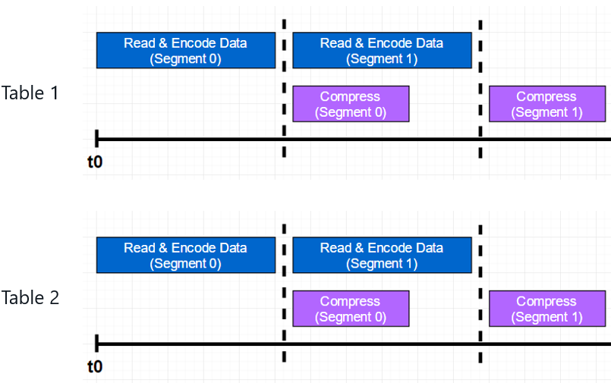
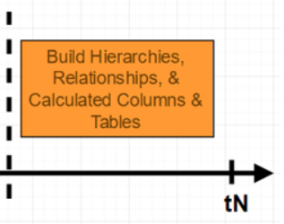
Parallel Processing (the correct way)
ProcessData
ProcessRecalc
Notes:
2 tables processed in parallel
2 partitions processed in parallel
Enterprise Edition (On-Prem)
Standard SKU (Azure)

Slide 23
Demo 02: Fine-Grained Control
Notes:
Show XMLA Read/Write in Premium Capacity Settings
Connect via SSMS
Show Partition
Show TMSL processing
Show TMSL processing Data
Show TMSL processing Recalc

Slide 24
Process Recalc
Builds any calculated columns, calculated tables, hierarchies, and/or relationships that need to be rebuilt.
Can only be run at the database-level
Always needed after a Process Data, Process Clear, or after merging partitions via TMSL/XMLA/TOM.
*Merging partitions via SSMS GUI includes a Process Recalc.
Never needed after a Process Full, Process Add, or Process Default (Recalc is built in)

Slide 25
Common Processing Strategies
ProcessFull at the database level
Pros: simple, data remains available for queries
Cons: requires most memory
Max Memory Usage 20 GB
10 GB
10 GB

Slide 26
Common Processing Strategies
ProcessClear + ProcessFull
Pros: simple, uses least amount of memory
Cons: database will be offline for however long it takes to complete ProcessFull
Max Memory Usage 10 GB
10 GB
10 GB

Slide 27
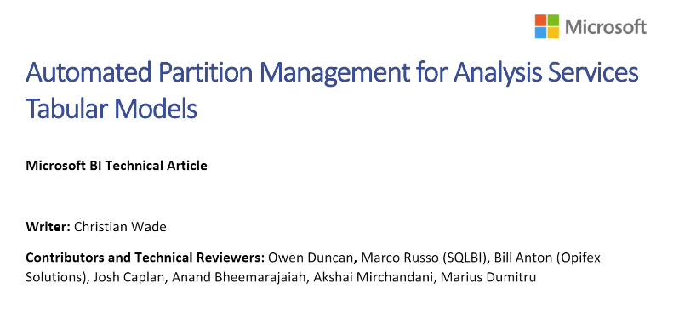
Common Processing Strategies
Incremental Processing
Pros: quick (can be “near” real-time)
Cons: complicated and expensive for Analysis Services
Notes:
EXPENSIVE:
Enterprise Edition (On-Prem Tabular)
Standard SKU (Azure AS)
PBI Premium
Resources:
Power BI Incremental Refresh: https://docs.microsoft.com/en-us/power-bi/service-premium-incremental-refresh
AS Partition Management:

Slide 28
Process Defrag
Only needed when dealing with partitions (e.g. incremental processing). At the table-level dictionaries are rebuilt.
Can be expensive on large tables but can have a dramatic performance improvement.
Can only be run using TMSL/XMLA/TOM

Slide 29
Less Common Strategies
ProcessAdd
Pros: very fast, minimal memory overhead
Cons: complicated to implement (e.g. Journalized tables, out-of-line binding)
Model Flipping
Pros: low latency
Cons: complicated and expensive
Notes:
Process Add append to segments
In practice many companies say they require (near) real-time…
Then they find out the true cost (DQ performance or $$$)

Slide 30

Picking a Processing Strategy
Requirements
Constraints

Slide 31
Picking a Processing Strategy
Requirements
Constraints

Slide 32
Picking a Processing Strategy
Requirements
Data Latency
Data Volume
Constraints
Resources (CPU, Memory, Network)
Length of Maintenance Window
Feature Limitations (Standard vs Enterprise / Pro vs Premium)
Notes:
REQUIREMENTS
How fresh does your data need to be?
Are you processing weekly, daily, hourly?
How much data in total
Processing during business hours adds a lot of complexity
CONSTRAINTS
Can these be adjusted? maybe

Slide 33
Pick a Processing Strategy
Requirements
Constraints
Process Full
Data Size | Latency
400 MB | Nightly
CPU | Window
8 cores, 32 GB memory | 6 hours
Notes:
Process Full

Slide 34
Pick a Processing Strategy
Requirements
Constraints
Incremental
Data Size | Latency
200 GB | Nightly
CPU | Window
8 cores 400 GB memory | 2 hours
Notes:
Incremental, ProcessAdd if possible

Slide 35
Pick a Processing Strategy
Requirements
Constraints
Incremental
Data Size | Latency
40 GB | 30 min
CPU | Window
8 cores, 128 GB memory | none
Notes:
Incremental
use max parallelism to limit threads during business hours
ProcessDefrag weekly or monthly (if using a rolling window technique)

Slide 36
Pick a Processing Strategy
Requirements
Constraints
Trick Question
Data Size | Latency
40 GB | Weekly
CPU | Window
8 cores, 32 GB memory | 10 hours
Notes:
Trick question

Slide 37
Performance Considerations
Data Source(s)
Network
Semantic Layer
Notes:
Network
Yours?
Azures?
Yours and Azures?
3rd Party, Yours and Azures?

Slide 38
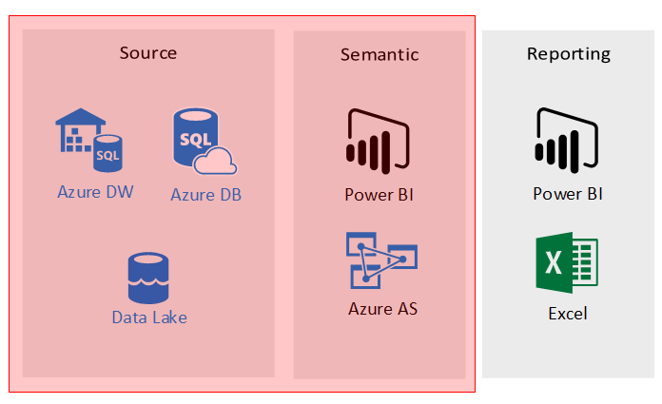
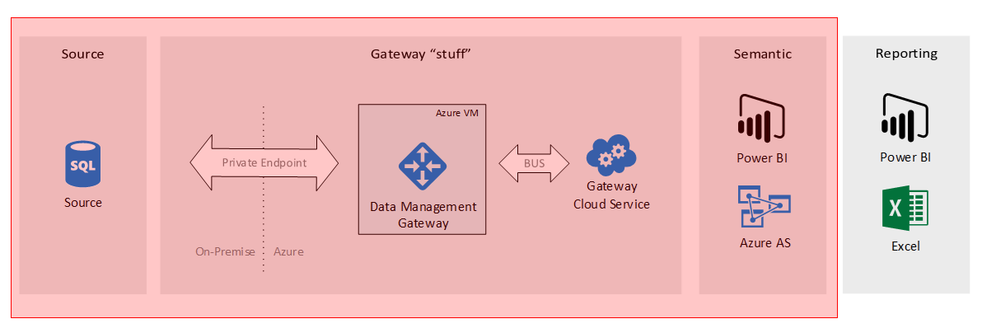
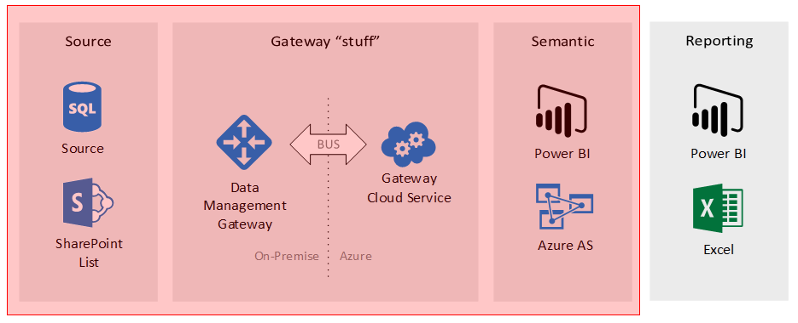
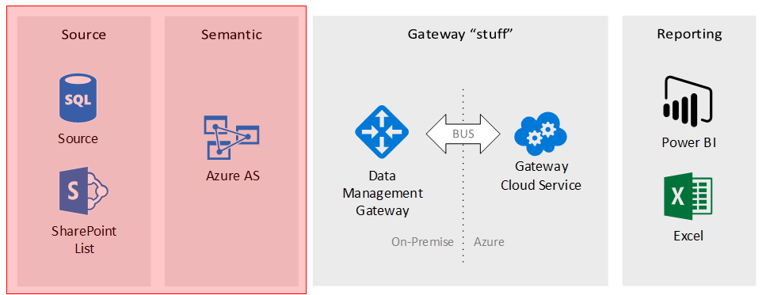
Performance Considerations
Notes:
Network
Yours?
Azures?
Yours and Azures?
3rd Party, Yours and Azures?

Slide 39
Performance Considerations
Processing is resource intensive (CPU, Memory)
Balance is key!
Throughput vs Resource Constraints
Intra-day Processing vs Overnight?
Don’t forget to tune the source

Slide 40
Additional Resources (Analysis Services)
Performance Tuning of Tabular Models in SQL Server 2012 Analysis Services
https://blogs.msdn.microsoft.com/karang/2013/08/02/sql-2012-tabular-performance-tuning-of-tabular-models-in-sql-server-2012-analysis-services/
Refresh Command (TMSL) https://docs.microsoft.com/en-us/sql/analysis-services/tabular-models-scripting-language-commands/refresh-command-tmsl?view=sql-analysis-services-2017
As Partition Processing (Whitepaper + Code) https://github.com/Microsoft/Analysis-Services/tree/master/AsPartitionProcessing
Performance Monitoring (DIY)
http://byobi.com/2016/02/performance-monitoring-for-ssas-extended-events-cheat-sheet/ http://byobi.com/2016/03/performance-monitoring-for-ssas-perfmon-counter-cheat-sheet/

Slide 41
Additional Resources (Power BI)
Incremental refresh in Power BI
https://docs.microsoft.com/en-us/power-bi/admin/service-premium-incremental-refresh
Power BI Premium and Azure Analysis Services
https://powerbi.microsoft.com/en-us/blog/power-bi-premium-and-azure-analysis-services/
Power BI Rest API https://docs.microsoft.com/en-us/rest/api/power-bi/
Power BI Premium Metrics app
https://docs.microsoft.com/en-us/power-bi/admin/service-premium-metrics-app

Slide 42

Questions?
anton@opifexsolutions.com
Downloads and additional references: https://github.com/byobi/PBI-Refresh

